Slide 1

Front End for a Magnetic Transmitter
Team #9
Aethan Cubitt
Ben Jarrin
Jacob Janson
External Supervisors
Dr. Jean F. Bousquet
Dr. Parisa Rangraz
Internal Supervisor
Dr. Jacek Ilow

Slide 2
Presentation Overview
Background
Project Overview
System Architecture
System Verification
Project Planning
Testing & Results
Analysis & Discussion

Slide 3
Problem Statement
We aim to establish underwater-to-surface communication using Magnetic Induction. This requires generating and transmitting a strong, clean analog sinusoidal signal via a large induction coil to create a changing magnetic field. The current through the coil shall be 5 Amps.

Slide 4
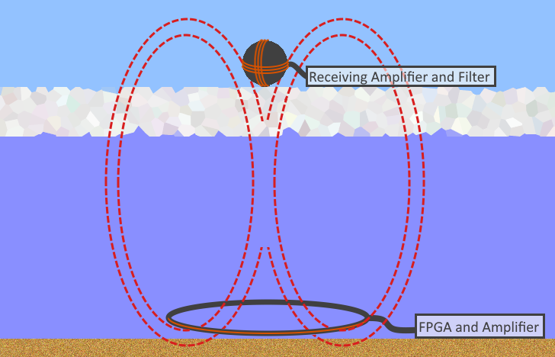
Project Overview
Signal
Sine waves at 100 Hz, 1kHz, and 10kHz
Transmitter
Under water and ice
Amplifier
Receiver (out of scope)
Above ice
Amplifier and filter
Quantum
Notes:
We want to be able to send a signal of 10kHz (max 30kHz) to through ice and water from below to a receiver above the ice.
We will have a transmitter below the water (at the Dal Aquatron which will be described later) to send MI waves through the water to the receiver which will filter and amplify the signal.
Eventually, the receiver will incorporate superconductors but that is outside of what we are doing for this project.

Slide 5
Goals & Deliverables
To transmit a sine wave from underwater to above the surface.
FPGA
Signal generation
Capacitor bank control
Transmitter PCB
Analog to pulse width modulation of signal with amplification to 125 Watts
Low Pass filter circuit with inductor as load
Capacitor switching bank in series with load
Power management
Notes:
To transmit the magnetic wave through water the following subsystems are required.

Slide 6
System Architecture
FPGA
Analog to PWM
H-Bridge
Low Pass Output Filter
Capacitor Bank
Transmitter Coil
Transmitter PCB

Slide 7
FPGA System Architecture
Signal Generator
Signal
User Input
Pin Out
Capacitor Control
Pin Out
Pin Out

Slide 8
Proposed Solution

Slide 9
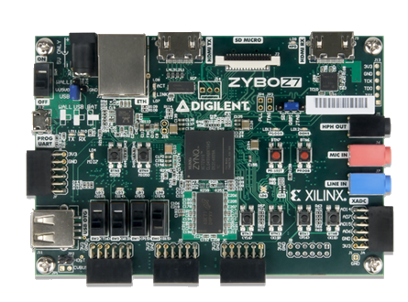
FPGA Design
Board: Zybo Z7-10
The two HDL modules will output the following:
1. Signal for 100Hz, 1kHz, or 10kHz
2. Capacitor control to match the signal choice
The FPGA output is fed into the TPA3255 PCB

Slide 10
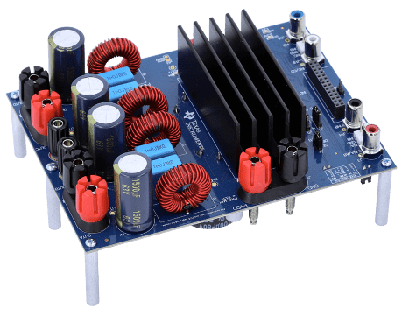
Transmitter: Amplifier
Amplifies the FPGA analog signal to 125 Watts – 5 Amps
Uses the TPA3255 Class D audio amplifier, to boost a small analog signal to a large Pulse Width Modulated (PWM) signal
The TPA3255 has been repurposed from an audio amplifier, to combine the encoding signals for the H-Bridge, and the H-bridge itself

Slide 11
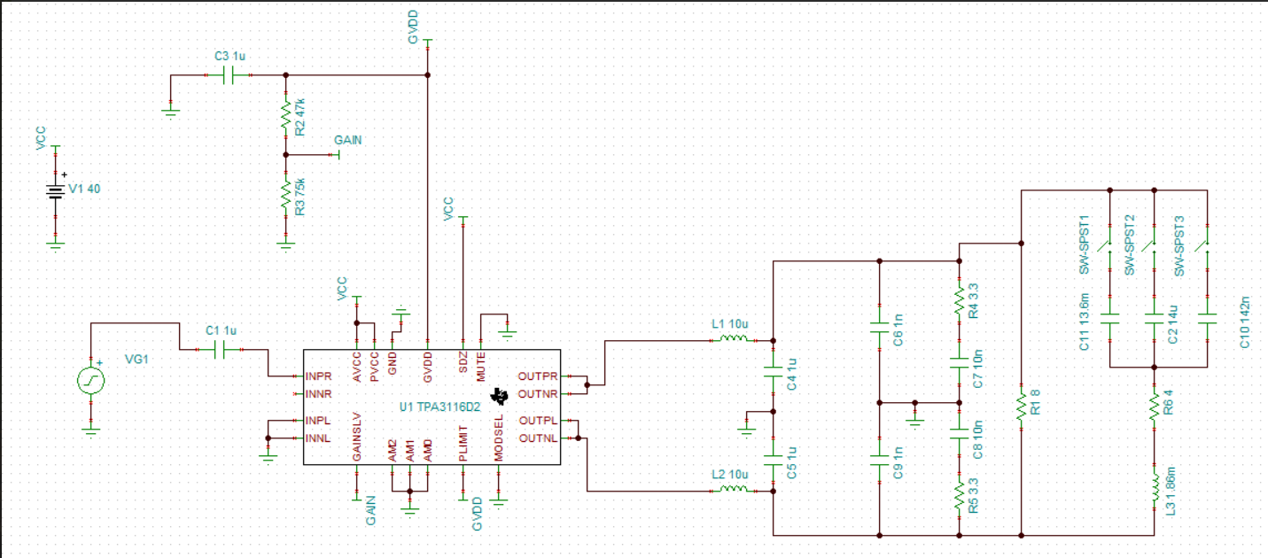
Simulated Amplifier Circuit

Slide 12
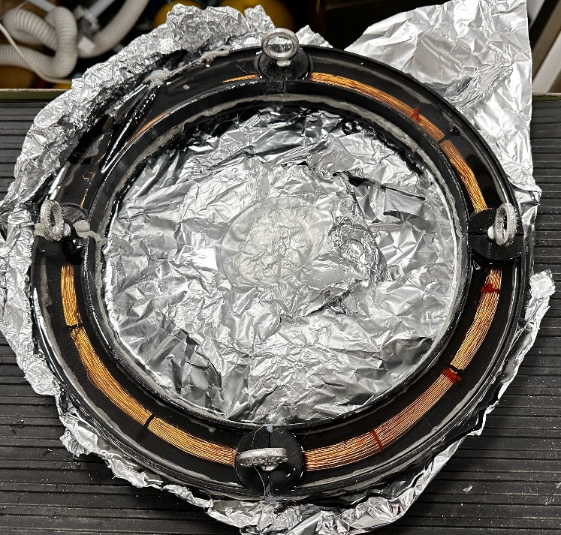
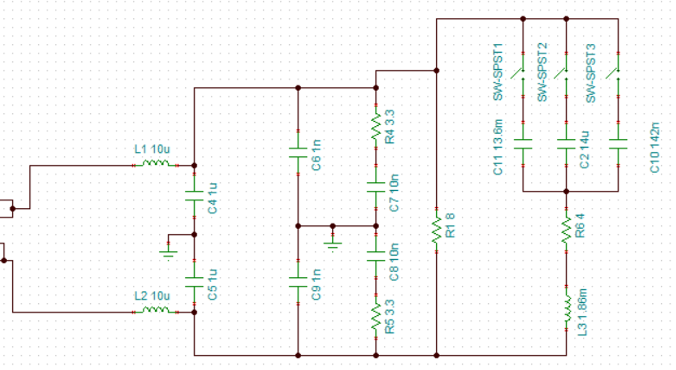
Low Pass Output Filter & Coils
Load is a large inductor.
The low pass filter takes output PWM signal and creates a smooth voltage wave with 5 Amps of current across the load.
Coil Size increased from AWG 24 to AWG 20 to safely support current output.

Slide 13
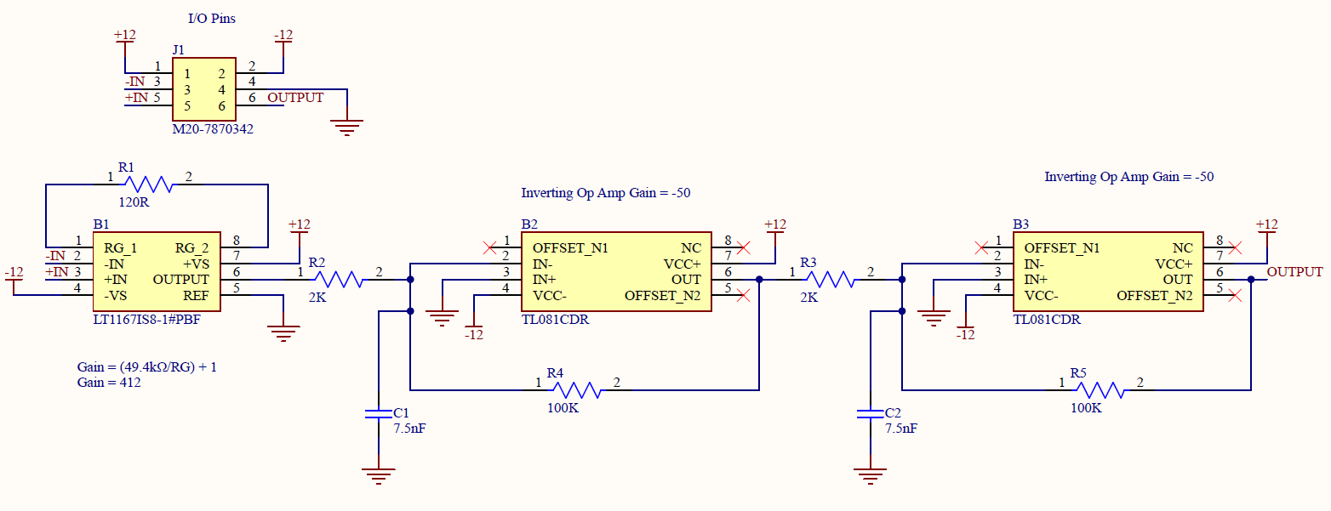
Receiver
Second stage of receiver.
Incorporates a low-noise amplifier, inverting amplifiers, and filters in a cascaded configuration.
Purpose: amplify signal picked up by coils and filter out noise introduced in the channel for successful detection by the processor.
Works with +-12V dual power supply for testing and with 24V automotive d-cell lithium batteries.

Slide 14
Team Structure
Project Manager
Aethan Cubitt
Responsibilities
Time management
External point of contact
LP Output Filter
H-Bridge Amplifier
Software Lead
Jacob Janson
FPGA block coding
Quantum input handling
User interface
Hardware Lead
Ben Jarrin
Amplifier PCB design
Receiver circuit design
LP Output Filter
H-Bridge Amplifier

Slide 15
High-level Project Schedule
Winter
Design and modelling of receiver
Sept-Oct
FPGA Design
Test System Integration
System Assembly
Amplifier Design
Amplification Literature Review
LP output Filter Design
Nov-Dec
PCB Design

Slide 16
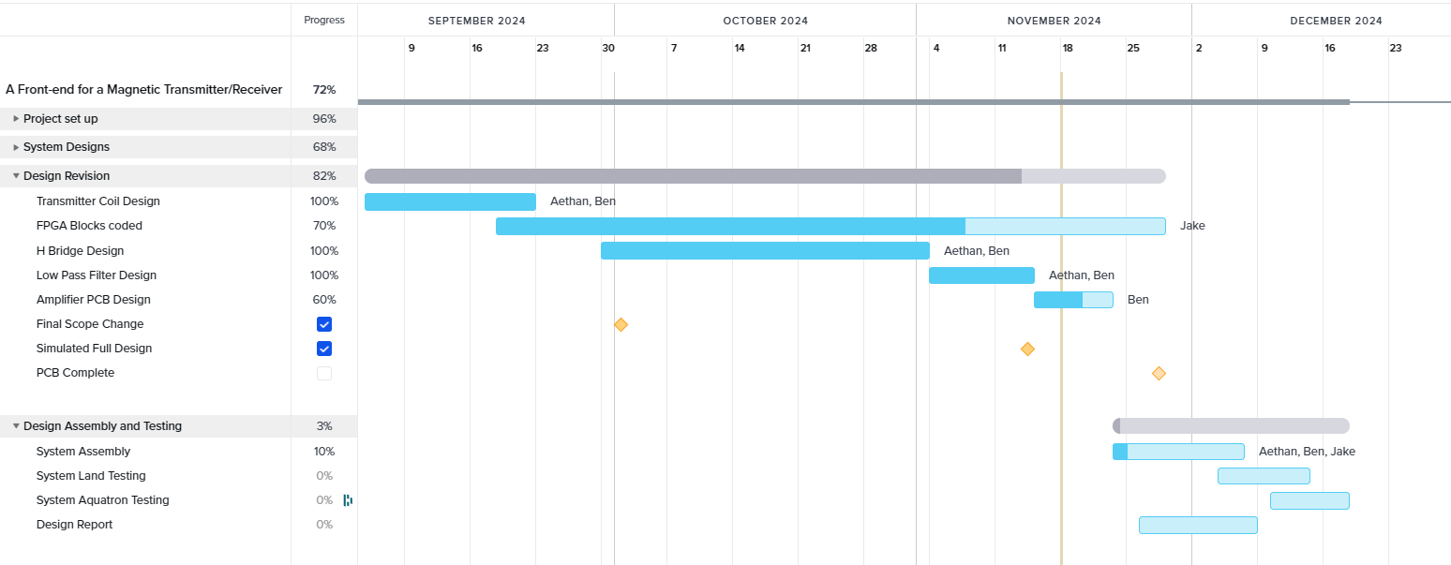
Project Schedule

Slide 17
Materials Breakdown
Materials from previous years
FPGA board
Measurement equipment
Receiver
Materials acquired
20 AWG Wire
Amplifier PCB printing and components
Lab computer

Slide 18
Budget Summary
Total Initial Budget of $1000
Current estimated cost $1750
Item | Cost per item ($) | Quantity | Cost ($)
PCB Board & components | 250 | 1 | 250
New computer | 1500 | 1 | 1500
Notes:
https://www.ibuypower.com/store/rdy-trace-7mp-009

Slide 19
Safety
Working with up to 25 Volts at 5 Amps
To achieve a safe design, we:
Increased coil wire gauge
Added a protective cover over high-power circuit
Built in a fuse to protect from over current
This is medium voltage and requires mandatory safety measures:
Flame resistant (FR) clothing
Smock
Hand and eye protection

Slide 20
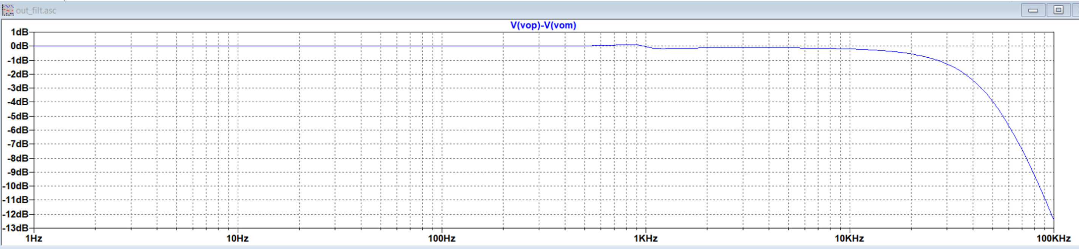

Simulation Test Results
The low pass filter flattens high frequencies and allows our targeted frequencies through.

Slide 21
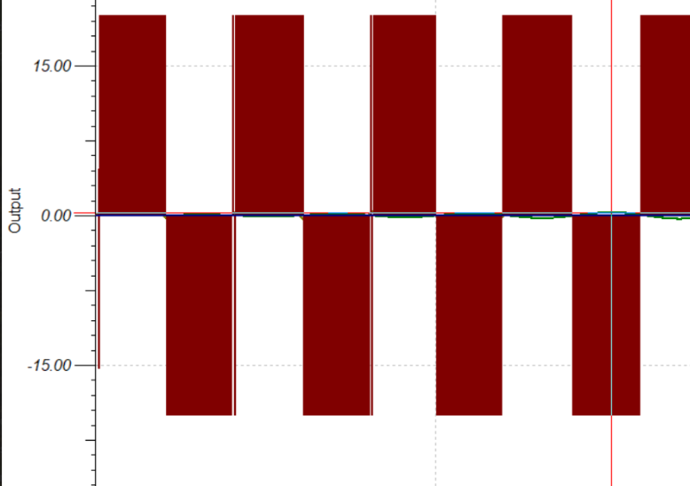
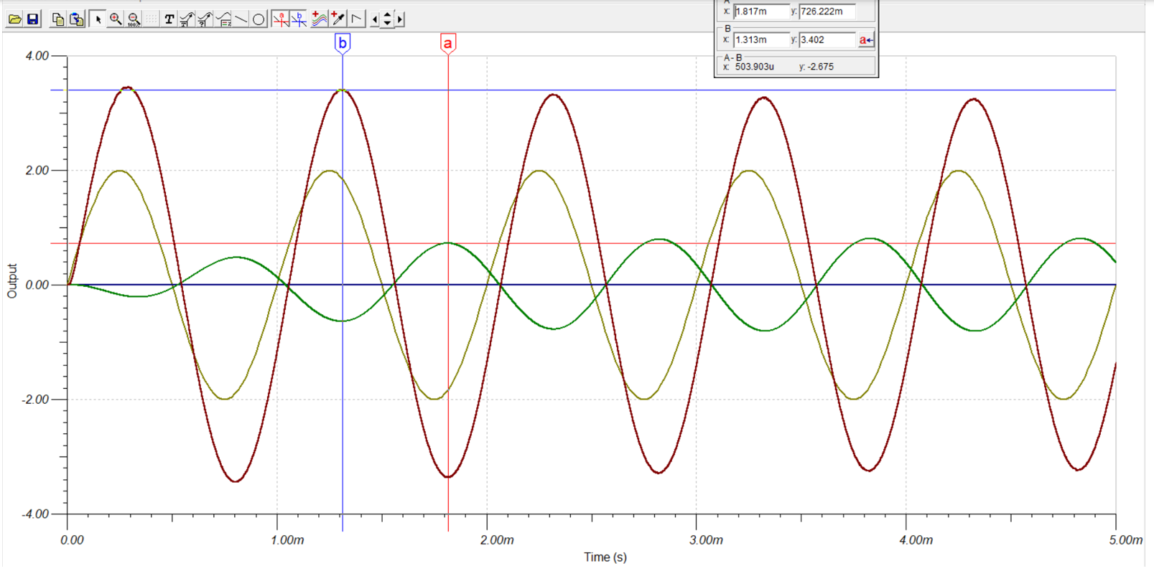
Simulation Test Results
The low pass filter successfully filters the PWM input
3.00
-3.00

Slide 22
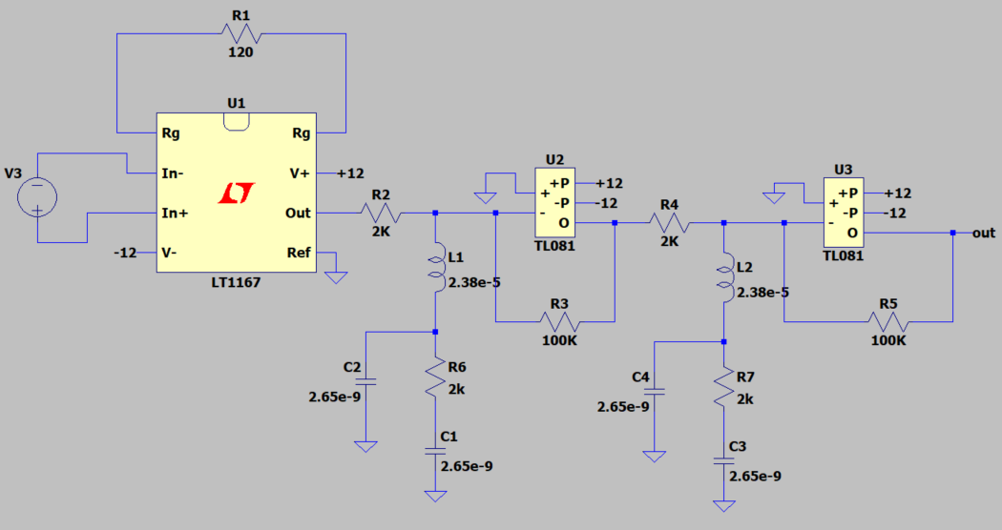
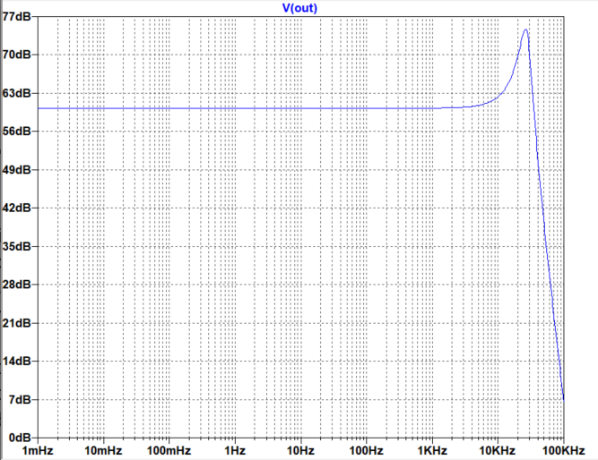
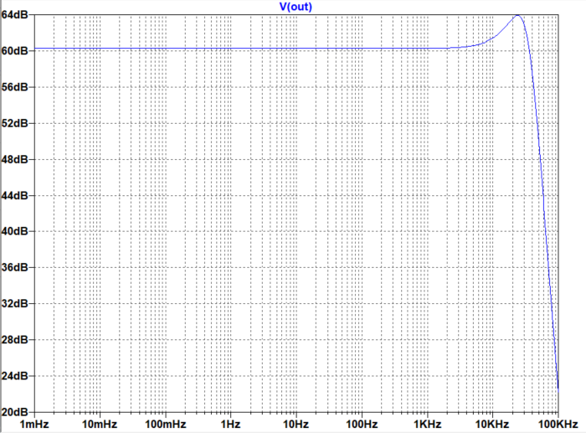
Receiver V1
Low-pass filters with 30kHz cutoff frequency.
First-order RC and third-order RLC filters have been simulated for comparison.
Bandpass filter to be considered 100Hz – 30KHz passband.
RC Filter Frequency Response
3rd Order RLC Filter Frequency Response

Slide 23
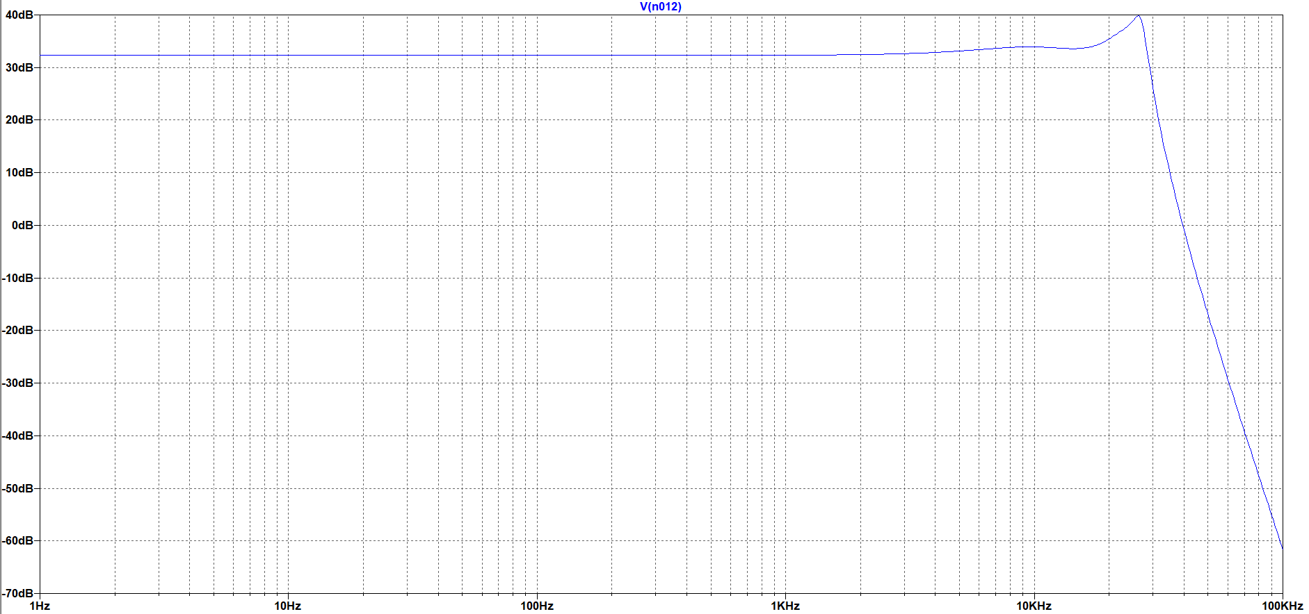
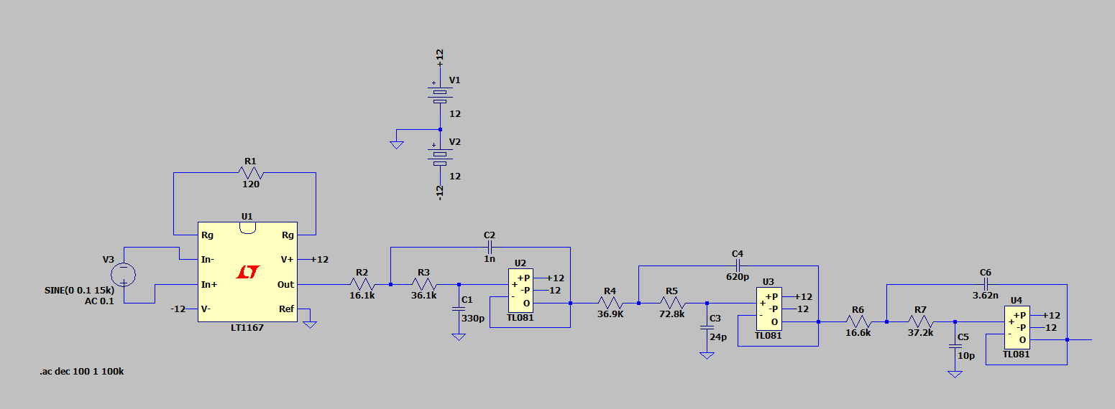
Receiver V2
Sixth order active Chebyshev filter with 30kHz cutoff frequency.
Improved frequency response by decreasing the overshoot.
Decrease in overall amplification to better suit signal needs.

Slide 24
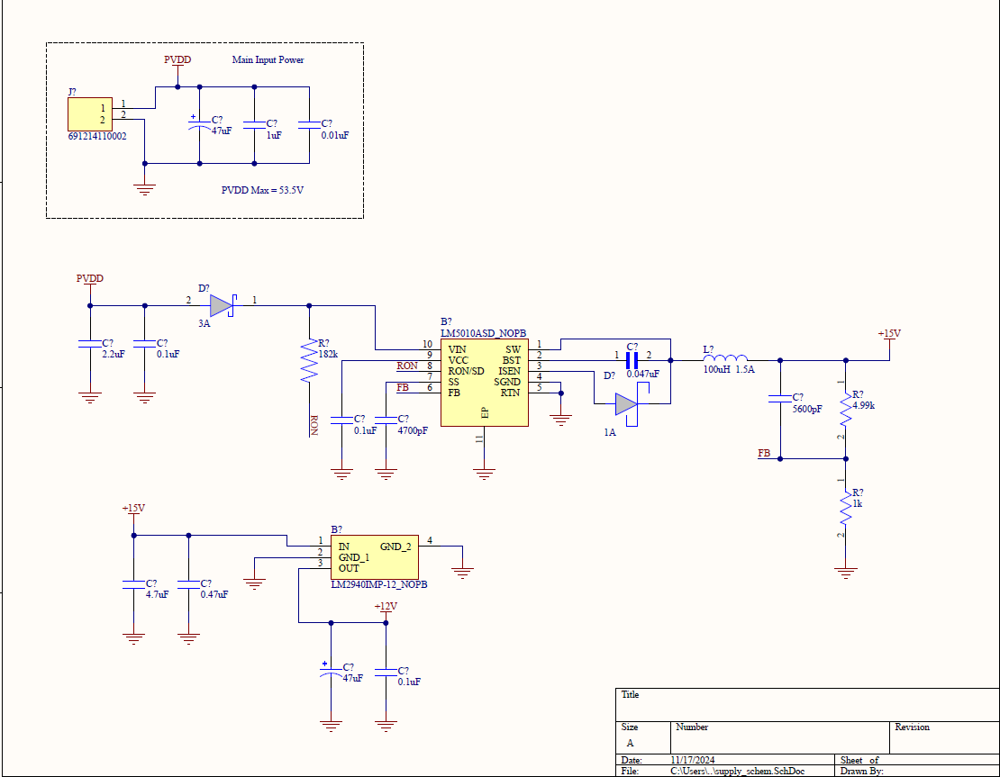
PCB Power Management Schematics

Slide 25
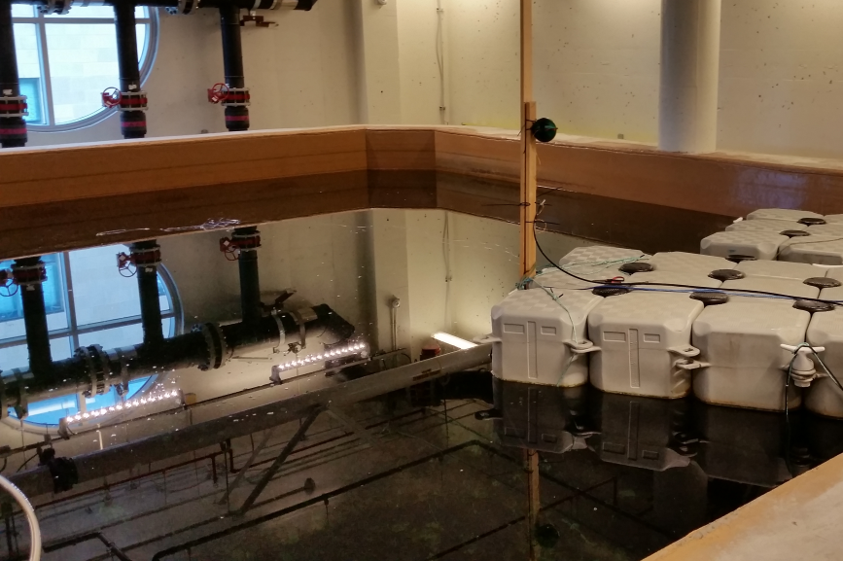
Verification & Testing Plan
Select 100Hz, 1kHz, and 10kHz to send through PCB
Send signal from 5m away from the receiver
Measure the output of the amplifier to confirm minimal noise through the newly built receiver
Receiver outputs will be read to an oscilloscope

Slide 26
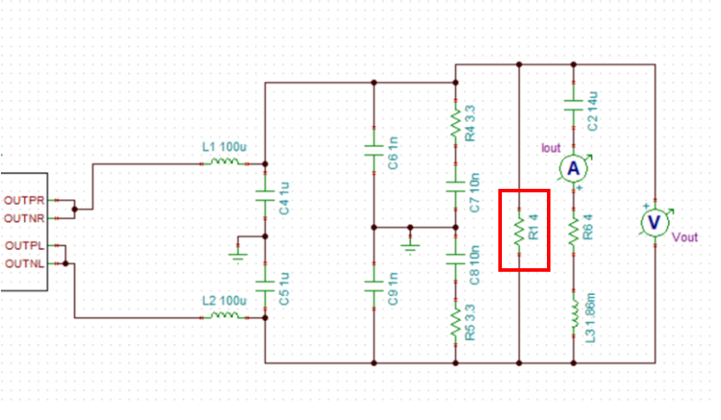
Critical Analysis & Recommendations
The resistor in parallel reduces the amount of power that reaches the transmission coils by more than 50%
Encoding the PWM H-Bridge signals on the FPGA would allow for more PCB design control
Testing of the system should be done first in a dry lab, followed by Dalhousie’s Aquatron

Slide 27
Thank You

